Slide 1
Feature Extraction and Price Prediction for Mobile Phones
Ankit
Next Hikes Pvt ltd
Data Analysis and Machine Learning Approach

Slide 2
Objective
The objective of this project is to analyze the key features that influence smartphone prices and build a predictive machine learning model to estimate mobile phone prices based on these features.
Goals:
Understand the dataset through Exploratory Data Analysis (EDA)
Identify important features affecting mobile prices
Build a machine learning model to predict prices
Provide insights for pricing strategy

Slide 3
Dataset Overview
The dataset contains detailed information about various smartphones including their hardware specifications and prices.
Key Features:
Model
Colour
RAM
Memory
Battery Capacity
Rear Camera
Front Camera
Processor
Mobile Height
AI Lens
Price (Target Variable)

Slide 4
Data Cleaning
Before analysis, the dataset was cleaned and prepared.
Steps performed:
Removed unnecessary columns (Unnamed column)
Checked for missing values
Verified duplicate records
Converted camera values from text to numeric
Ensured correct data types

Slide 5
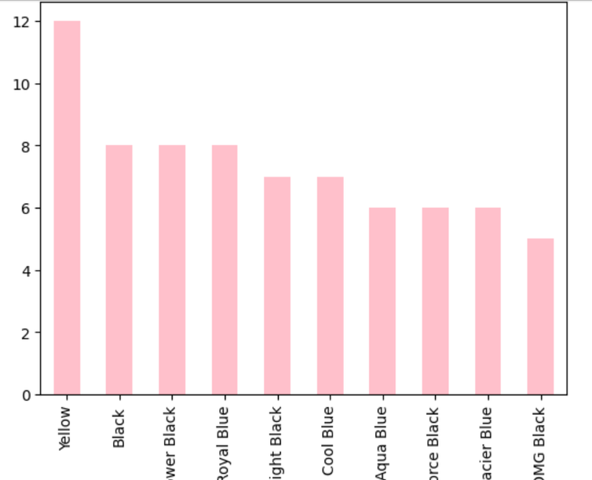
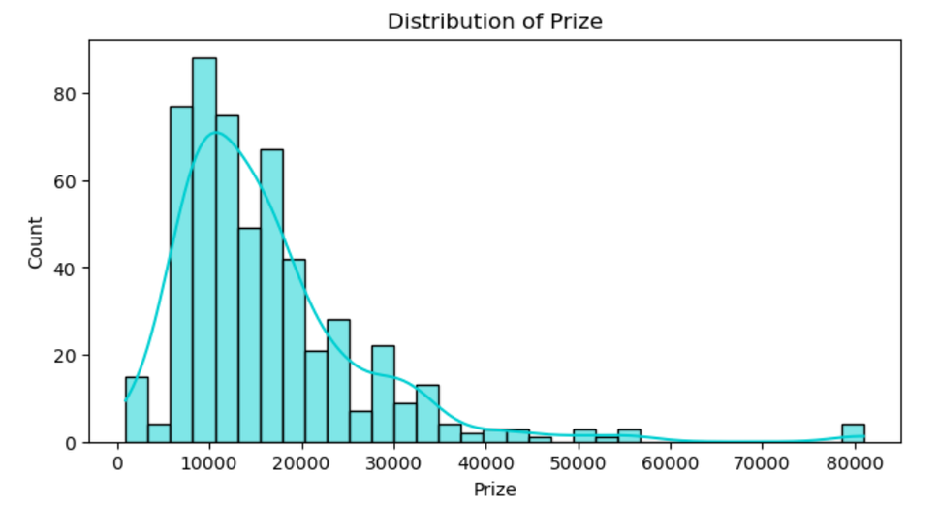
Univariate Analysis
Univariate analysis was performed to understand the distribution of individual numerical features such as price, RAM, memory, battery capacity, and camera specifications.
This analysis helps identify common configurations and understand how smartphone specifications are distributed in the dataset.
Add screenshots of these charts:
Prize distribution
Battery distribution
RAM distribution
Memory distribution
Key observations:
Most smartphones fall in the ₹7,000 – ₹20,000 price range
4GB, 6GB, and 8GB RAM configurations are most common
Storage options 64GB and 128GB dominate the market
Most devices have battery capacities around 5000 mAh

Slide 6
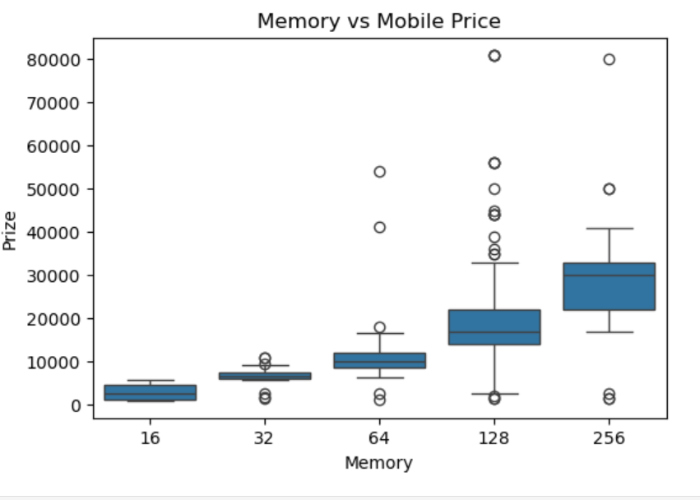
Bivariate Analysis
Bivariate analysis was performed to examine the relationship between smartphone features and price.
This helps identify which hardware features influence smartphone pricing.
Major observations:
Smartphone price increases with higher RAM configurations
Devices with larger storage capacities tend to be more expensive
Processor type significantly impacts smartphone pricing
Battery capacity shows weaker influence on price

Slide 7
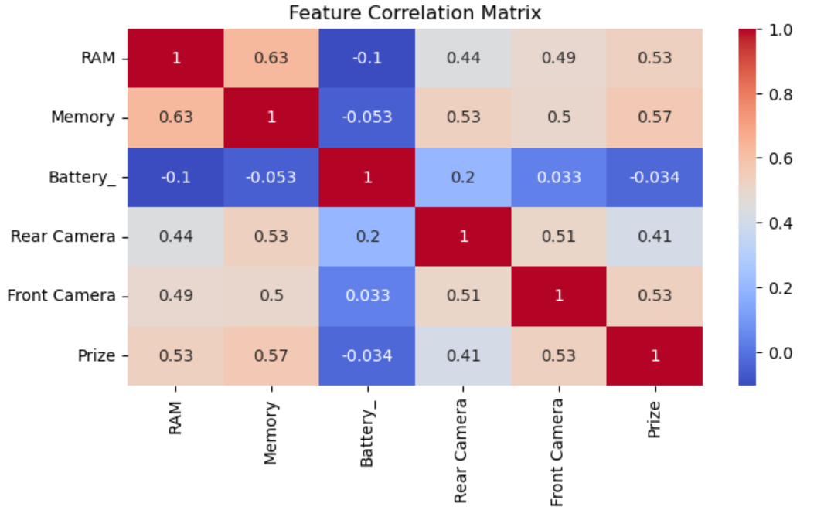
Multivariate Analysis
Multivariate analysis helps understand relationships among multiple features simultaneously.
A correlation heatmap was used to identify the strength of relationships between different smartphone features and price.

Slide 8
Key Drivers of Mobile Phone Price
High Impact Features
RAM
Memory (Storage)
Processor Type
These features show strong relationships with smartphone prices and are major indicators of device performance.
\

Slide 9
Feature Importance Insights
Based on correlation and feature analysis, the most influential factors affecting smartphone price are:
High Impact Features
RAM
Memory
Processor Type
Moderate Impact
Camera specifications
Low Impact
Mobile height
AI lens

Slide 10
Conclusion & Business Recommendations
Key findings:
Performance-related features such as RAM and storage strongly influence price
Processor type plays an important role in defining smartphone market segments
Camera features contribute to price but are not the primary driver
Recommendation:
Smartphone manufacturers should focus on improving performance-oriented features such as RAM, storage, and processors to justify higher pricing strategies.

Slide 11
Thanks
Ankit

